Slide 1

FULLSTACK PROJECT
ASCEND YOGA(NomadicMonk)

Slide 2

TEAM MEMBERS
1. SANAL MISHRA
2.SARVENDRA KR.SINGH
3.PRABHAT KR. SINGH
4.YASH SINGH
Mentor: Mr. PANKAJ KAPOOR

Slide 3

What Is This Project?
As we all know that the current situation is so harsh and full of negativity. This pandemic has taken our life aside from the normal track. It is affecting mentally and physically every human from teenagers to adult one.
According to the survey, 61% of Indians are angry and depressed due to this pandemic. So the only way to reattain the mental piece and physical fitness is yoga.
Yoga leads to the union of individual consciousness with that of the universal consciousness, indicating a perfect harmony between the mind and body, man and nature.
So, our project is a Yoga website giving information about various types of yoga and providing courses to the users in the presence of the yoga trainers to avoid physical injuries.

Slide 4
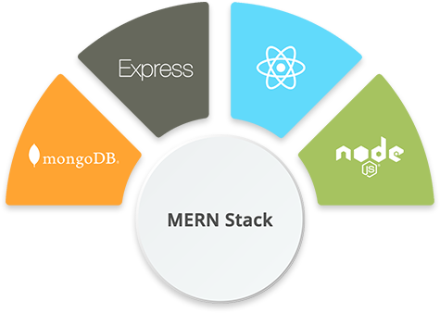
What Is MERN STACK?
The MERN stack is a JavaScript stack that's designed to make the development process smoother. MERN includes four open-source components: MongoDB, Express, React, and Node.js.
These components provide an end-to-end framework for developers to work in.

Slide 5

MongoDB: Cross-platform Document-Oriented Database
MongoDB is a NoSQL database where each record is a document comprising of key-value pairs that are similar to JSON (JavaScript Object Notation) objects.
MongoDB is flexible and allows its users to create schema, databases, tables, etc. Documents that are identifiable by a primary key make up the basic unit of MongoDB.
Once MongoDB is installed, users can make use of Mongo shell as well. Mongo shell provides a JavaScript interface through which the users can interact and carry out operations (eg: querying, updating records, deleting records).

Slide 6
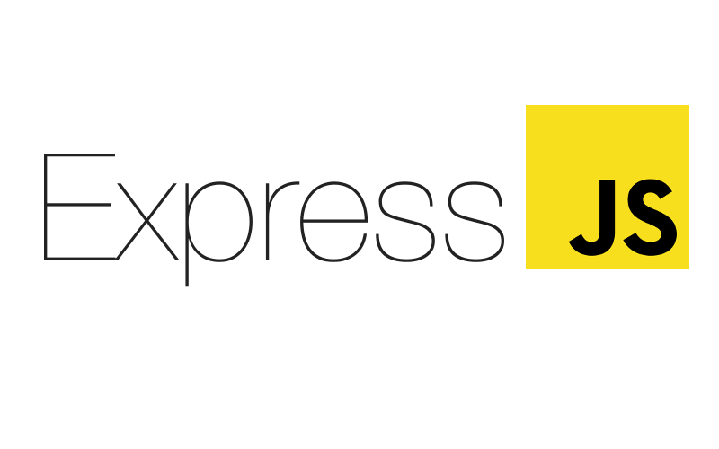
Express: Back-End Framework
Express is a Node.js framework. Rather than writing the code using Node.js and creating loads of Node modules.
Express makes it simpler and easier to write the back-end code.
Express helps in designing great web applications and APIs.
Express supports many middlewares which makes the code shorter and easier to write.

Slide 7
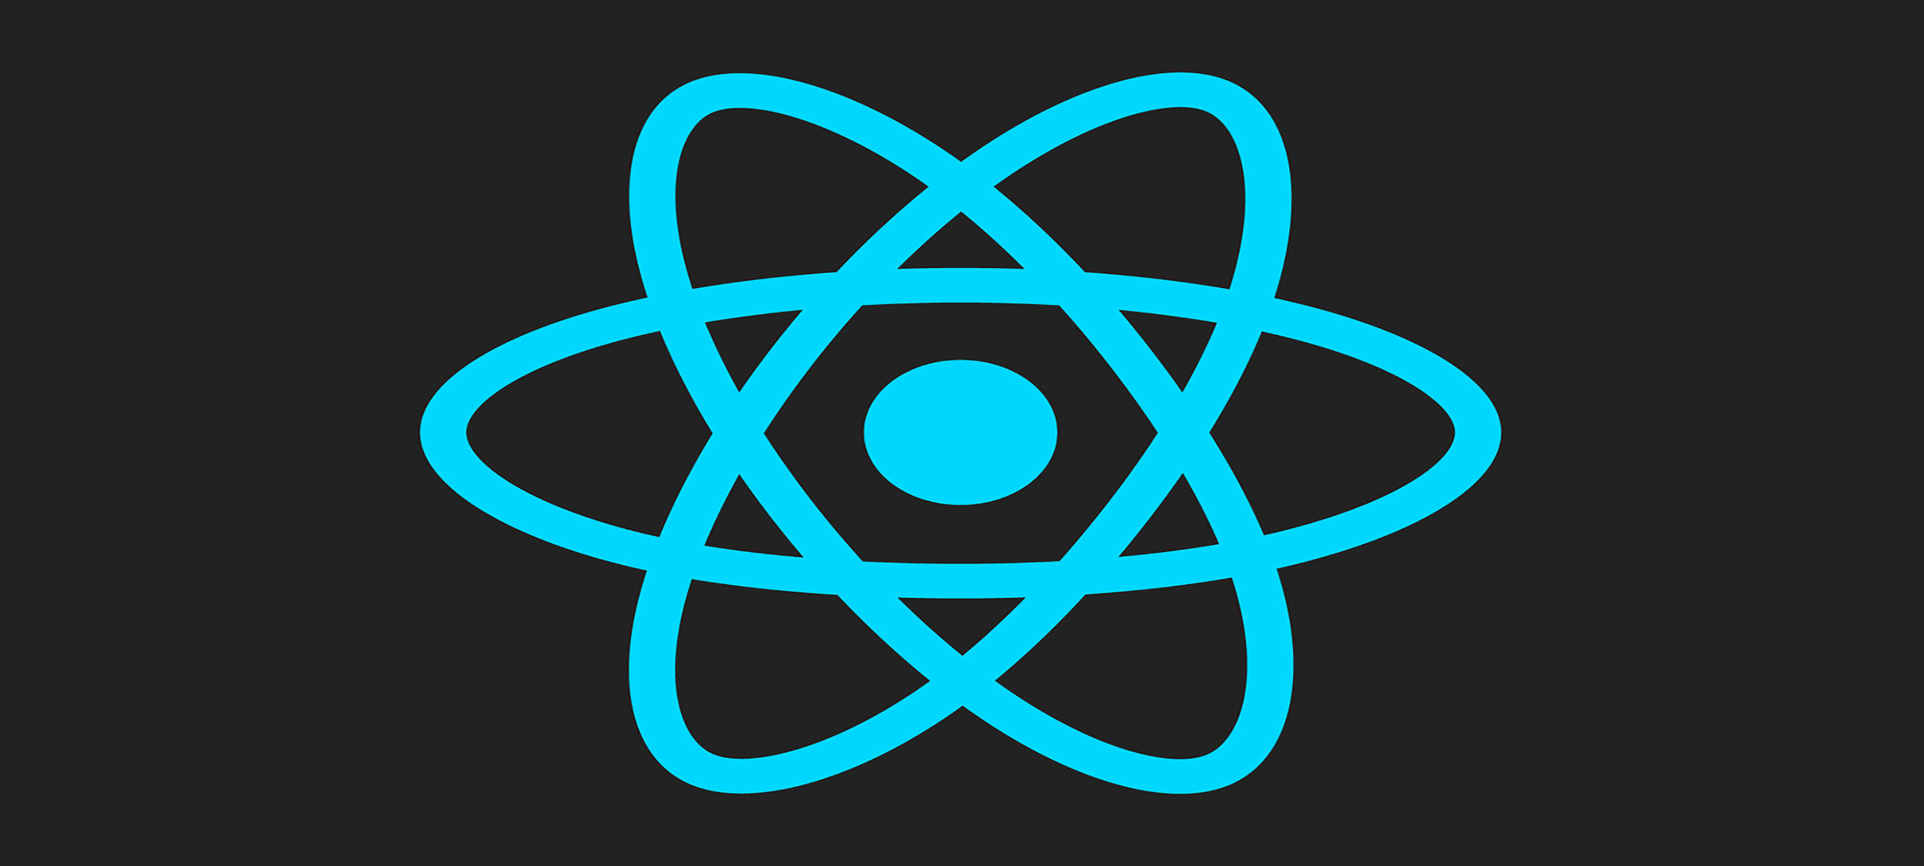
React: Front-End Library
React is a JavaScript library that is used for building user interfaces.
React is used for the development of single-page applications and mobile applications because of its ability to handle rapidly changing data.
React allows users to code in JavaScript and create UI components.

Slide 8
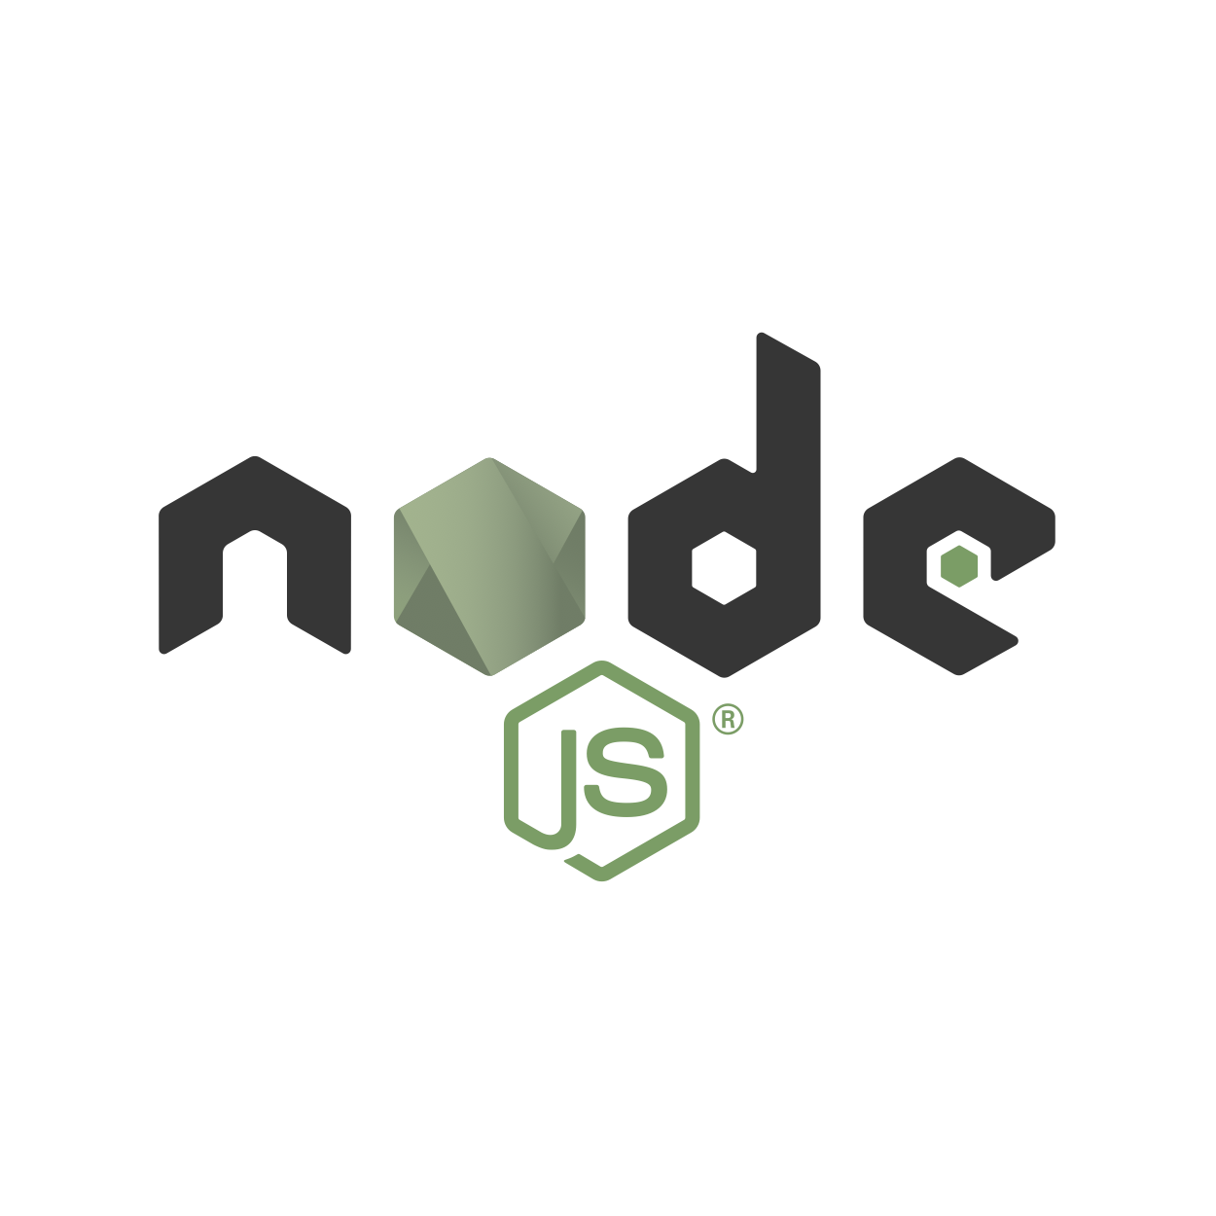
Node.js: JS Runtime Environment
Node.js provides a JavaScript Environment which allows the user to run their code on the server (outside the browser).
Node pack manager i.e. npm allows the user to choose from thousands of free packages (node modules) to download.

Slide 9

Some Related Output Screenshots

Slide 10
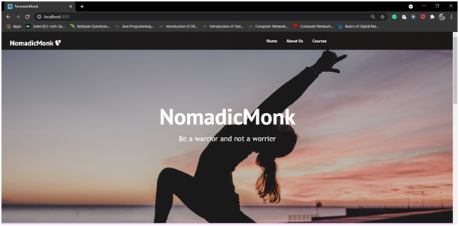

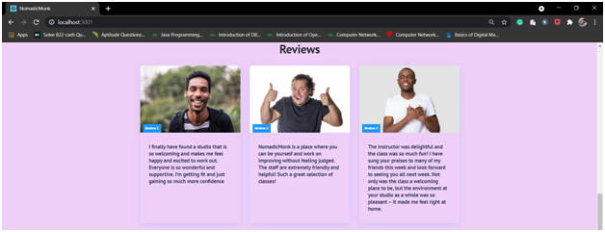
Landing Page (Home Page)

Slide 11
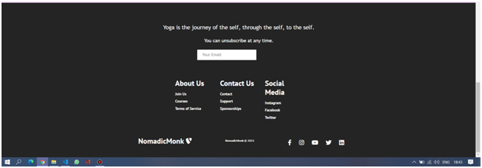
Contd..

Slide 12
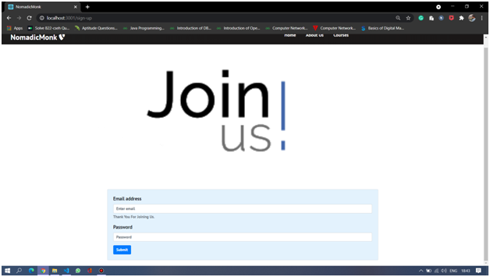
Contd..

Slide 13
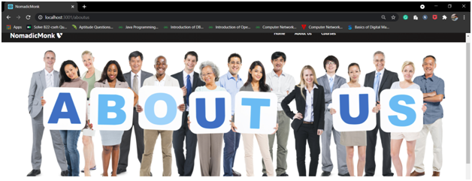
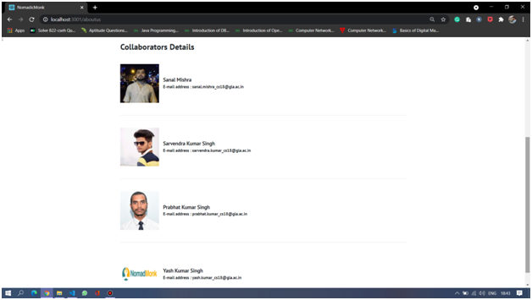
Contd..

Slide 14
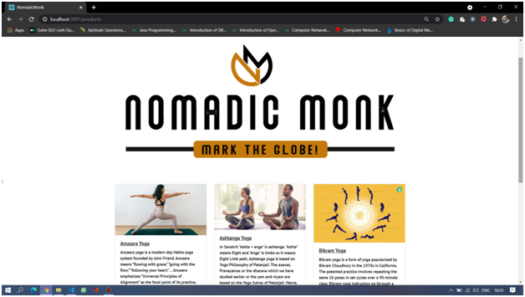
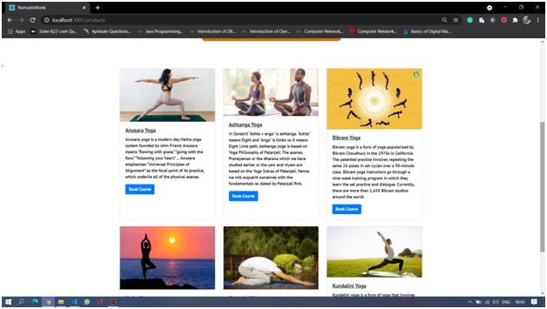
Contd..

Slide 15
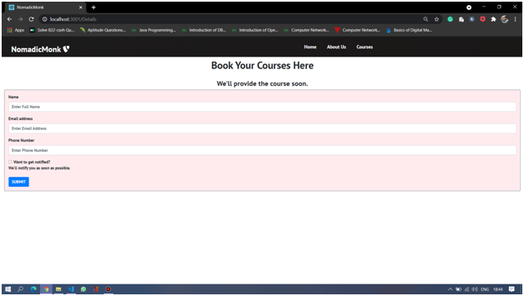
Contd..

Slide 16


